Slide 1


THE ECONOMIC CASE FOR GREENING THE GLOBAL RECOVERY THROUGH CITIES
Publication launch
14 September 2020
Nick Godfrey
Programme Director
7 Priorities for National Governments
Authors: Gulati, M., Becqué, R., Godfrey, N., Akhmouch, A., Cartwright, A., Eis, J., Huq, S., Jacobs, M., King, R., Rode, P.

Slide 2




























Our Coalition

Slide 3

We build the political commitment for a compact, connected, clean and resilient model of urban development
OUR MISSION
OUR VISION
Support national level decision makers to meet their economic, social, and climate goals through transforming cities
Zero carbon, resilient and inclusive
cities by 2050 empowered and
enabled by national governments

Slide 4
When cities prosper, so do countries
80% of
global GDP
75% of energy-related emissions
50% of the population – over 2/3 by 2050

Slide 5
Cities are at the epicenter of the
COVID-19 crisis
Dwindling tax revenues
Deepening inequalities
Record unemployment
Rising health costs
Increasing pressure on stretched public services

Slide 6
Cities as a core solution to the COVID-19 economic and health crises
National policymakers have three key priorities in the short term:
jobs, equity, resilience
Investing in cities as part of recovery packages can help national governments create much needed economic security and jobs today;
AND
Can enable rapid strides towards a low-carbon, resilient, and inclusive future tomorrow
National government leadership and investment is urgently needed to complement sub-national efforts

Slide 7
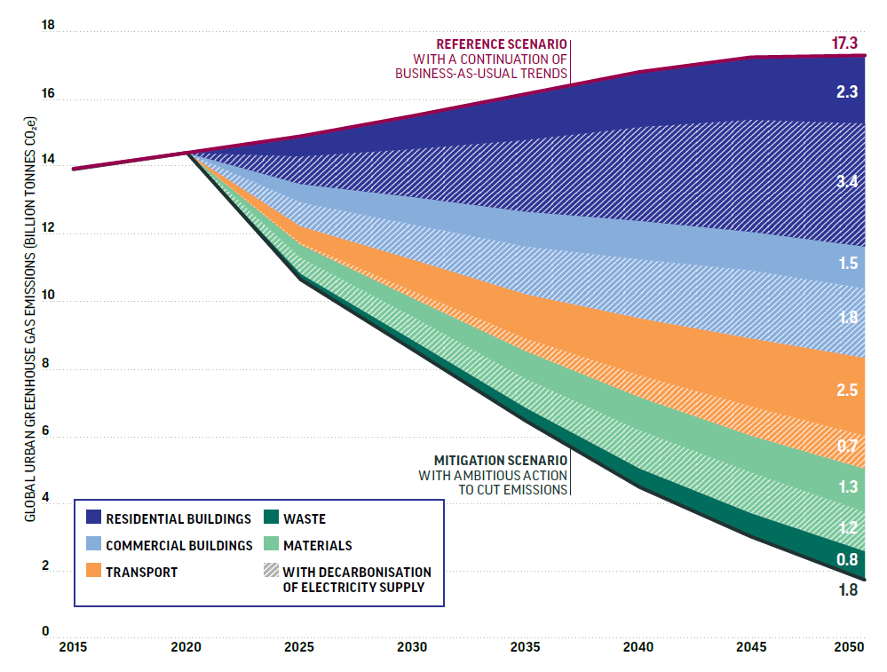
Investments in cities offer some of the highest potential to unleash economic activity and increase health outcomes
A net zero urban transformation would:
Require new investment of ~2% of global GDP per year
Yield annual returns of US$2.8 trillion per year by 2030, and US$6.9 trillion per year by 2050, from energy and material cost savings alone ($24 trillion NPV)
Support 87 million jobs in 2030, and 45 million jobs in 2050
Source: Stockholm Environmental Institute and Vivid Economics for the Coalition for Urban Transitions, 2019

Slide 8
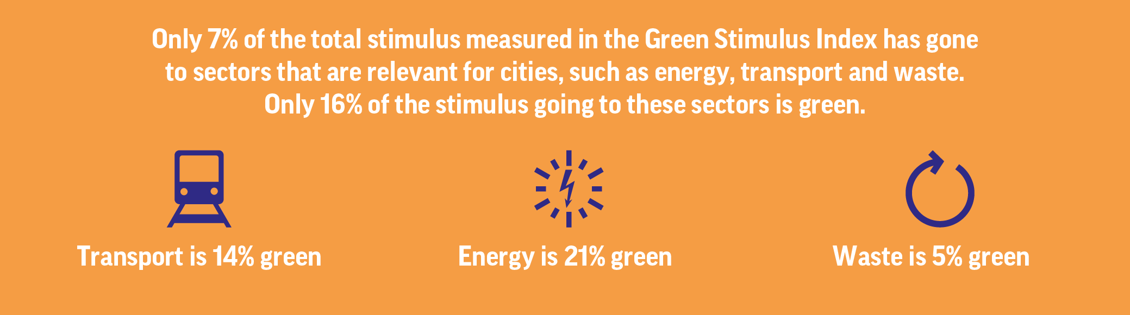
Yet only a fraction of stimulus so far has been directed towards green city measures

Slide 9
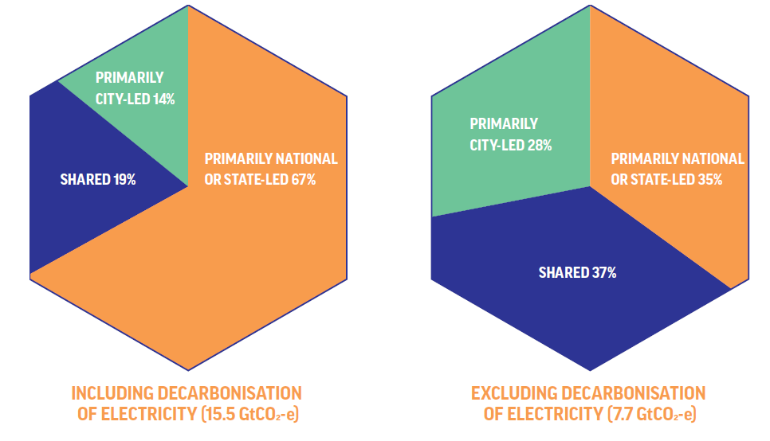
National governments have unique and crucial roles to play in driving a green urban recovery
Local governments cannot drive a green recovery alone:
Finances under severe strain
Strong reliance on national transfers
Many policies enabling investments in cities set at the national level
Source: Stockholm Environmental Institute for the Coalition for Urban Transitions, 2019
Notes:
Local governments cannot drive the zero-carbon transition on their own: national governments must play a critical role
New analysis for this report finds that, worldwide, national and state governments have primary authority over 35% of urban mitigation potential (excluding decarbonisation of electricity), including from improved cement production processes and more stringent efficiency standards for appliances, lighting and vehicles. Local governments have primary authority or influence over 28%, including compact urban form, travel demand management and waste disposal. 37% of the identified mitigation potential depends on collaborative climate action among national, regional and local governments, including building codes, decentralised renewables and mass transit infrastructure.
Bold national leadership is therefore needed to deliver these emission reductions and provide an enabling environment for local action
In the new analysis of powers, why have you separated the powers of different tiers of government into national and state led, local and city led, and multi-actor?
There is much global attention that has been given to the efforts of city governments, who are typically well-aware of their role in decarbonising cities. This report aims to remind us that these local-level governments cannot do it alone, hence grouping national and state together.
Additionally, in federal countries, states have many of the urban-relevant powers that national governments might hold in unitary countries (e.g. California on building codes). Hence our grouping.
Doesn’t this negate the narrative that cities are the bright spot in the climate action world?
On the contrary. Cities are still the bright spot for climate action. Low-carbon policies and investments in cities are often cost-effective, and generate wider benefits from new jobs to cleaner air. And city governments around the world should be commended for their ambitious climate commitments and innovative climate actions. Their ambition and energy has been a bright spot in international climate negotiations for over a decade.
But the Urban Opportunity report reminds us that city governments cannot create cities with net-zero emissions alone. In fact, it shows that they have primary authority over less than ⅓ of potential emission reductions in urban areas. This report therefore makes the case that much more collaborative action is needed, across different tiers of governments, if countries are to realise the many benefits of climate action in cities. National and state governments have primary responsibility for around ⅓ of urban mitigation potential, and the remaining 1/3 depends on different levels of government working together to cut emissions.
In short, cities are still the bright spot of the climate world. But this report demonstrates that far-sighted and supportive national leadership is needed to realise this urban opportunity.

Slide 10










7 priority areas for urban investment by national governments with significant net benefits
Cross cutting policy reforms that enhance impact of investments:
Fiscal reform
Governance reform
Financial reform
Job creation & protection
Social, environmental and health benefits
Economic prosperity
Reduced emissions
Increased resilience to health, economic and climate crises
Notes:
Full citation: Gulati, M., Becqué, R., Godfrey, N., Akhmouch, A., Cartwright, A., Eis, J., Huq, S., Jacobs, M., King, R., Rode, P. 2020. The Economic Case for Greening the Global Recovery through Cities: Seven priorities for national governments. Coalition for Urban Transitions, London and Washington, DC. Available at: https://urbantransitions.global/publications.

Slide 11






Create millions of jobs through a green urban recovery
Green construction and retrofits
Clean mobility
Renewable energy
Energy efficiency:
8-21 jobs
EV & public transport:
15-28 jobs
Fossil fuels:
3 jobs
Building roads:
8 jobs
Renewable energy:
8-28 jobs
Fossil fuels:
3 jobs
Active transport
Nature-based solutions
Waste and resources
Recycling,
reuse &
recovery:
3–20 jobs
Active transport infrastructure:
11-27 jobs
Tree planting,
restoration and
management:
40 jobs
Landfill and
Incineration:
0.1 jobs
Building roads:
8 jobs
‘Grey’ water
Infrastructure:
20 jobs
Per 1,000 tonnes of waste
Per US$1 million in spending
NB: For Clean R&D, the certainty around the direct job growth potential per US$1 million in spending is insufficient to provide a comparison
For all sources view The Economic Case for Greening the Global Recovery through Cities, Coalition for Urban Transitions, 2020
Notes:
Hepburn et al., 2020. W Top 5 of post-COVID fiscal recovery policies with highest economic multipliers combined with a high positive climate impact (source: Hepburn et al., 2020):
Renewable energy generation and storage
Building efficiency retrofits
Investment in education & training
Natural capital investment
Clean R&D spending

Slide 12
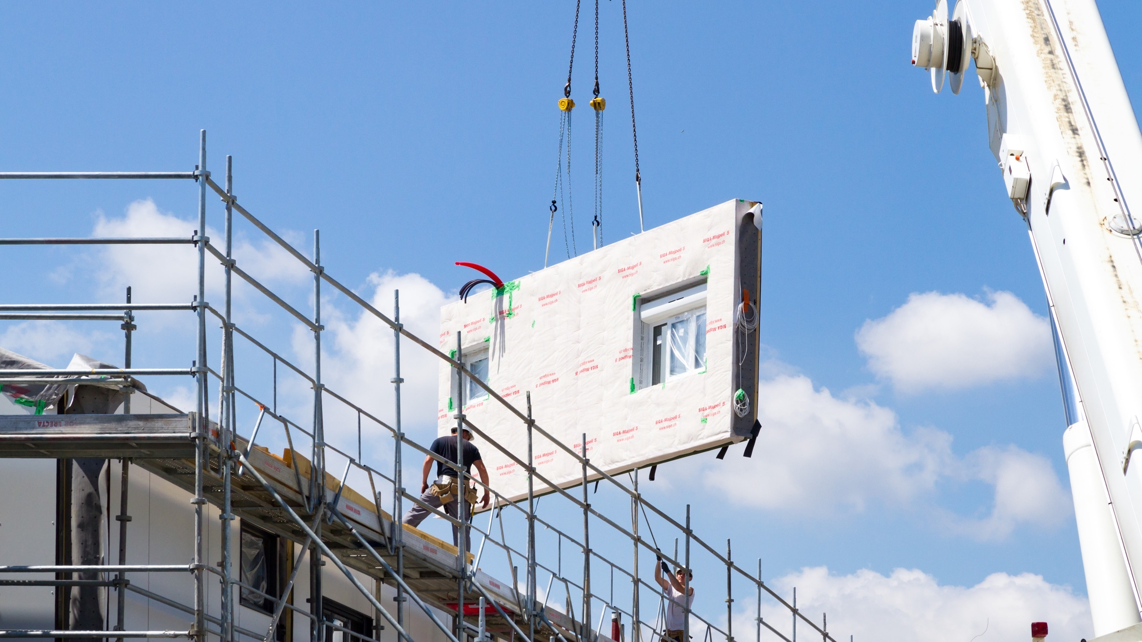
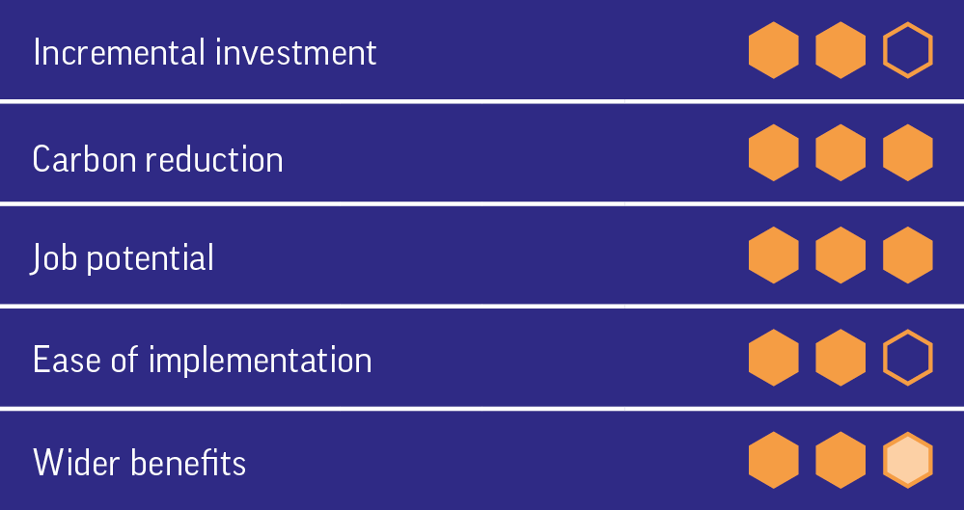

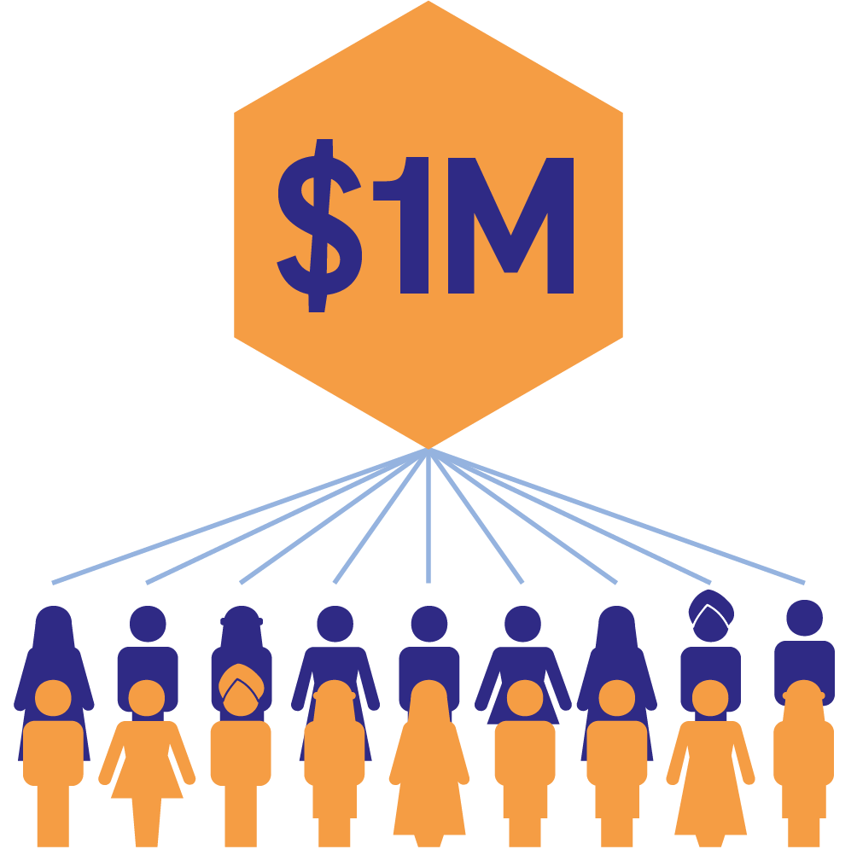
Green construction and retrofits
The carbon reduction potential of low- or zero-carbon construction and building energy efficiency retrofits is high: the built environment is responsible for up to 60% of cities’ carbon abatement potential and accounts for 40% of CO₂ emissions from energy worldwide.
Energy efficiency stimulus packages have previously generated 18 new jobs per US$1m invested
Action ready opportunities:
- Retrofit public buildings beyond code, providing initial wave of demand for the construction sector
- Use social distancing requirements to undertake energy retrofits with minimal disruption

Slide 13
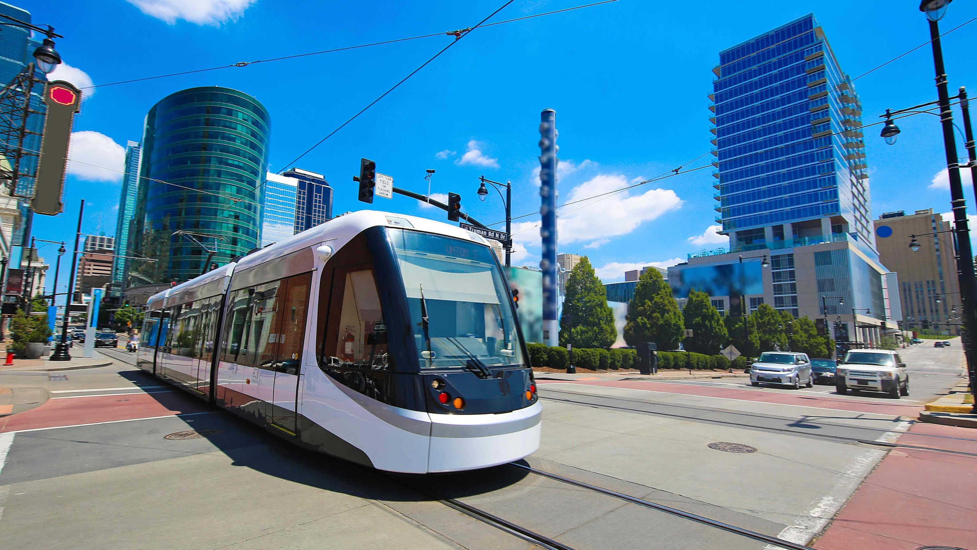
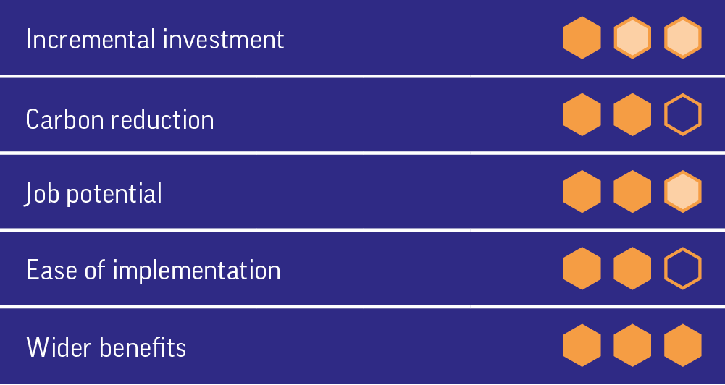

Clean mobility
Action ready opportunities:
- Implement dedicated public transport & high-occupancy EV vehicle lanes to curb post-COVID-19 surge in private vehicle use
- Tie automotive industry support to e-conversion schemes
- Use economic stimulus to explore new / innovative approaches to generating revenue for public transport provision
Investing in bus and rail schemes strongly supports more equal access to jobs, opportunities and education
The transport sector can deliver a fifth of cities’ carbon reduction potential, but with global ridership down 50-90%, the pandemic has struck a serious blow to public transport

Slide 14
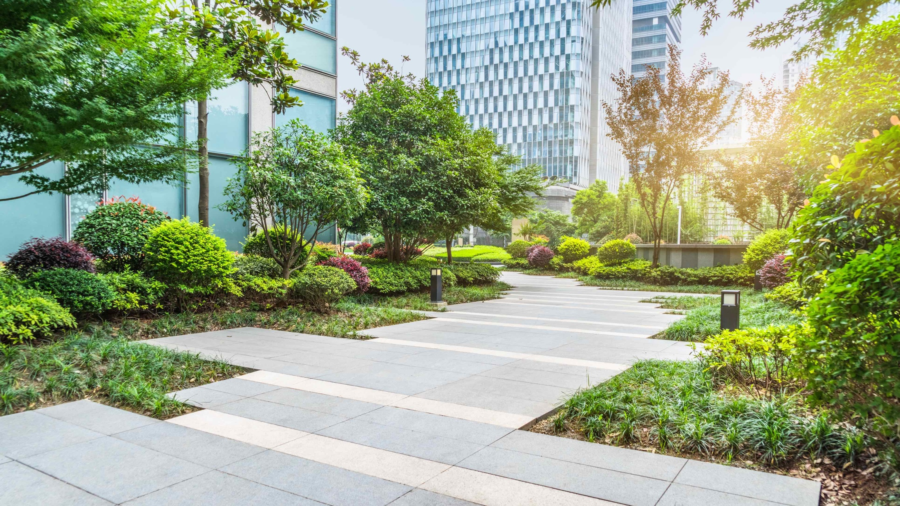

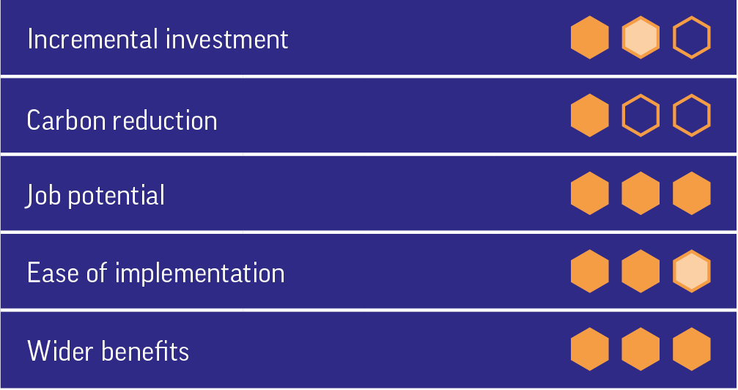

Nature-based solutions
Investing less than US$4 annually per resident on tree planting could improve the health of millions of people by curbing air pollution while reducing high temperature-related mortality by 2.4–5.6%.
For every US$1 million invested in reforestation and sustainable forest management, nearly 40 jobs can be supported.
Action ready opportunities:
Fast-acting, climate-friendly policies like afforestation and woodland management often have low worker training requirements, minimal planning and procurement prerequisites, and most aspects of the work meet social distancing requirements

Slide 15


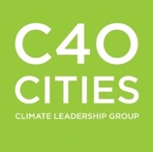

Thank you
#greenglobalrecovery
bit.ly/Green_Global_Recovery
Managed by
Paper funded by

