Slide 1
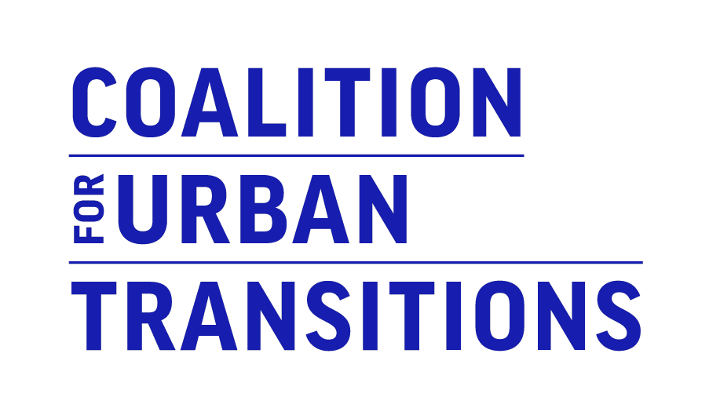
SEIZING Mexico's URBAN OPPORTUNITY
How urban transformation can reduce poverty and inequality and build resilience

Slide 2
About the Seizing Mexico’s Urban Opportunity report
Launched to support the COP26 UK Presidency in building momentum for enhanced climate ambition by national governments and other actors ahead of COP26 in Glasgow. Through insights from Mexico, it provides a call to action to tackle the triple challenges of COVID-19 recovery, economic development, and climate action by transforming cities.
It is a collaborative effort, created in consultation with experts and policymakers in Mexico, with additional input from more than 36 organisations across five continents, following from the foundational 2019 Climate Emergency, Urban Opportunity report.

Slide 3
The triple challenge facing Mexican Federal Government and the critical role of Mexican cities
Notes:
GVA and population numbers are specific to Mexico

Slide 4
Cities will be critical to solving triple challenge of recovery, development, and climate change
Cities are:
Economic engines, producing nearly 90% of Mexico’s GVA
Development and opportunity hubs, with efficiencies of scale, access to diverse job opportunities, vibrant communities, and cultural amenities
Notes:
Cities are central to Mexico’s vitality and need national leadership and support to realise their potential
Salvador, Brazil. Source: Travelhock/Shutterstock

Slide 5
Report Goals
This report explains how Mexico can recover from COVID-19 and achieve decarbonisation and economic growth by building low-carbon, resilient, and inclusive cities.
This report demonstrates both the opportunities and the challenges that cities of Mexico are currently facing. It provides specific policy recommendations to national government in unlocking the potentials of Mexico’s cities.

Slide 6
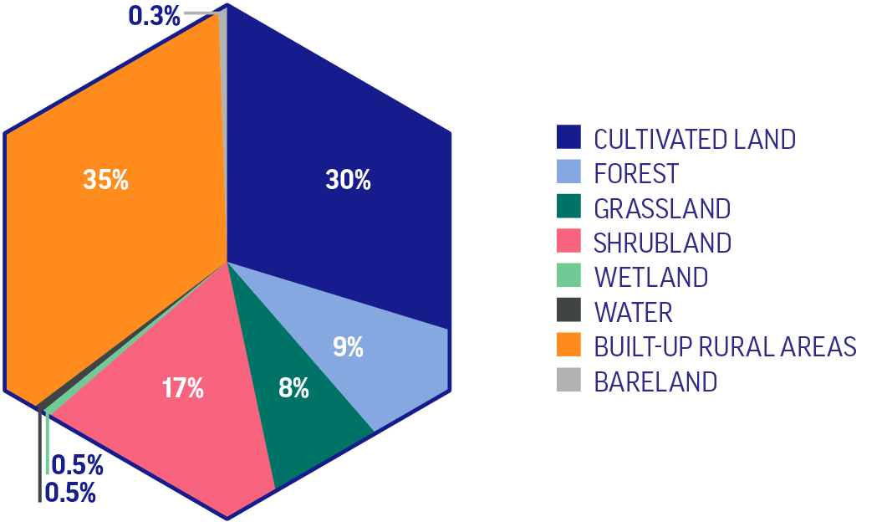
Mexico’s Cities are Already Facing Challenges
Mexico’s cities struggle with congestion, air pollution and sprawl, with some cities already experiencing severe climate change impacts.
Between 2000 and 2014, Mexican cities expanded by 1,821 km² – equivalent to more than the land area of Mexico City.
Important reforms are already underway, like the National Strategy of Territorial Planning 2020-2040 and the National Housing Programme, which work to make Mexico’s cities more resilient, sustainable and inclusive.
Land converted to urban areas in Mexico by type of land cover, 2000–2014
Source: Marron Institute of Urban Management, New York University, 2019, for the Coalition for Urban Transitions and the Food and Land Use Coalition

Slide 7
A significant amount of urban mitigation potential is in small and medium sized cities
More than half of Mexico’s urban abatement potential is in cities with fewer than 1 million people, and cities of 1-5 million people account for over one quarter of that potential.
Ensuring that small and medium sized cities have the knowledge and resources to grow sustainably and build resilience will be crucial to promoting broad-based prosperity across Mexico in the coming decades.
MEXICO’S PROPORTION OF MITIGATION POTENTIAL IN CITIES IN 2050
MEXICO
Source: Stockholm Environmental Institute for the Coalition for Urban Transitions, 2021
Notes:
Small to mid-sized cities hold a lot of opportunity for urban abatement potential

Slide 8
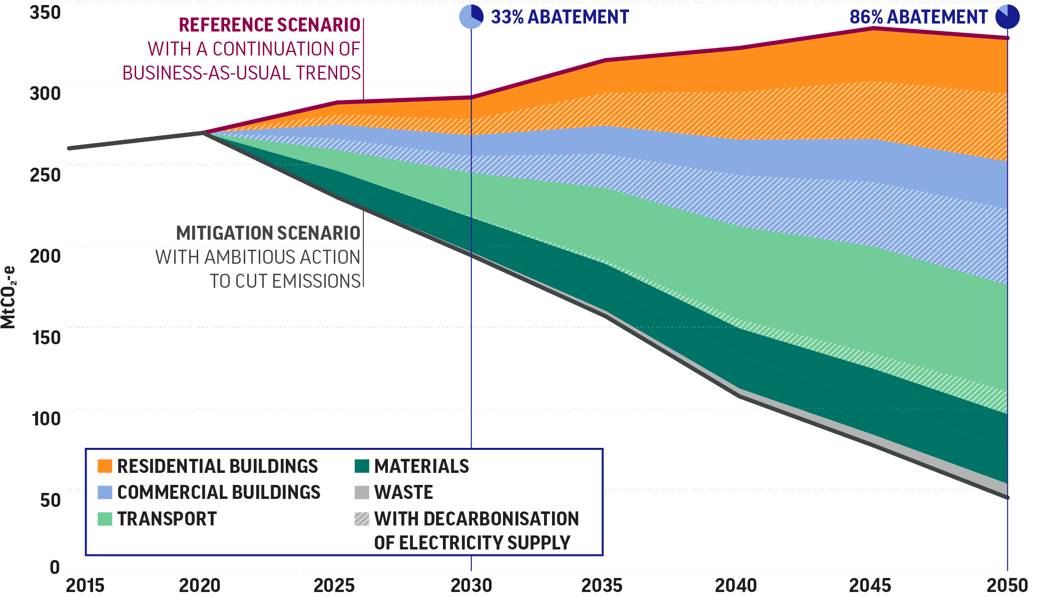
Investing in decarbonising Mexico’s cities could yield substantial economic benefits
Fully implemented the modelled low-carbon measures would:
Require incremental investments of US$960 billion
Yield returns with a net present value of at least US$210 billion by 2050, based on cost savings alone
Support over 0.5 million new jobs in 2030, mostly in energy efficiency in the buildings sector
Technically feasible potential to reduce GHG emissions
from MEXICAN cities by 2050, by sector
Source: Modelling by the Stockholm Environment Institute for the Coalition

Slide 9
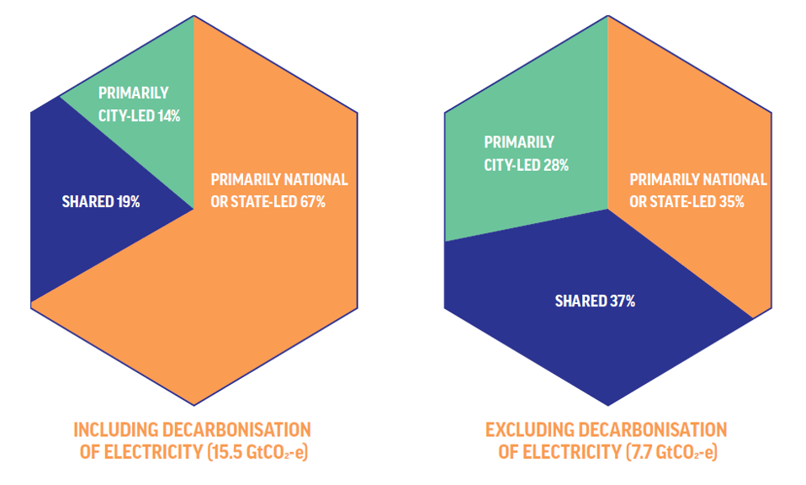
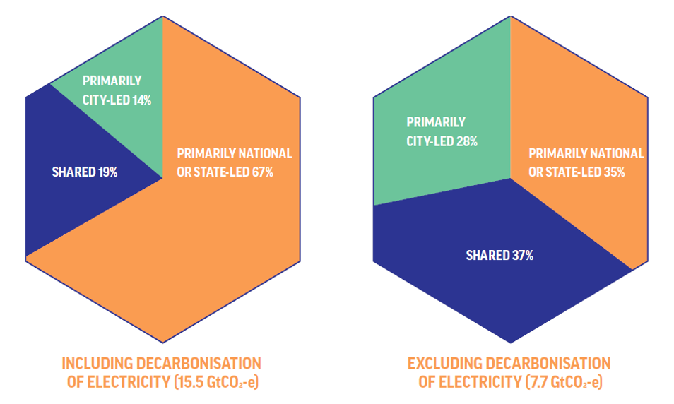
Local governments cannot drive the zero-carbon urban transition alone
National leadership to seize the urban opportunity will be critical
National or other higher-tier governments have primary authority over the measures required to achieve two-thirds of global urban abatement potential, including decarbonisation of electricity.
Notes:
These numbers are global, not specific to Mexico

Slide 10
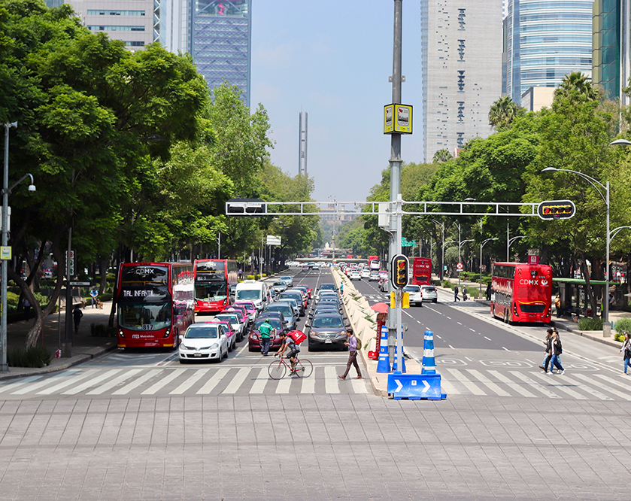
Recommendations
Supporting the creation of metropolitan authorities for integrated land use and transport planning
Expanding the supply of affordable and well-situated housing connected to public transport
Prioritising a just transition to zero-carbon cities, with special attention to poor and marginalised people
Notes:
Mexico. Source: Albert John

Slide 11
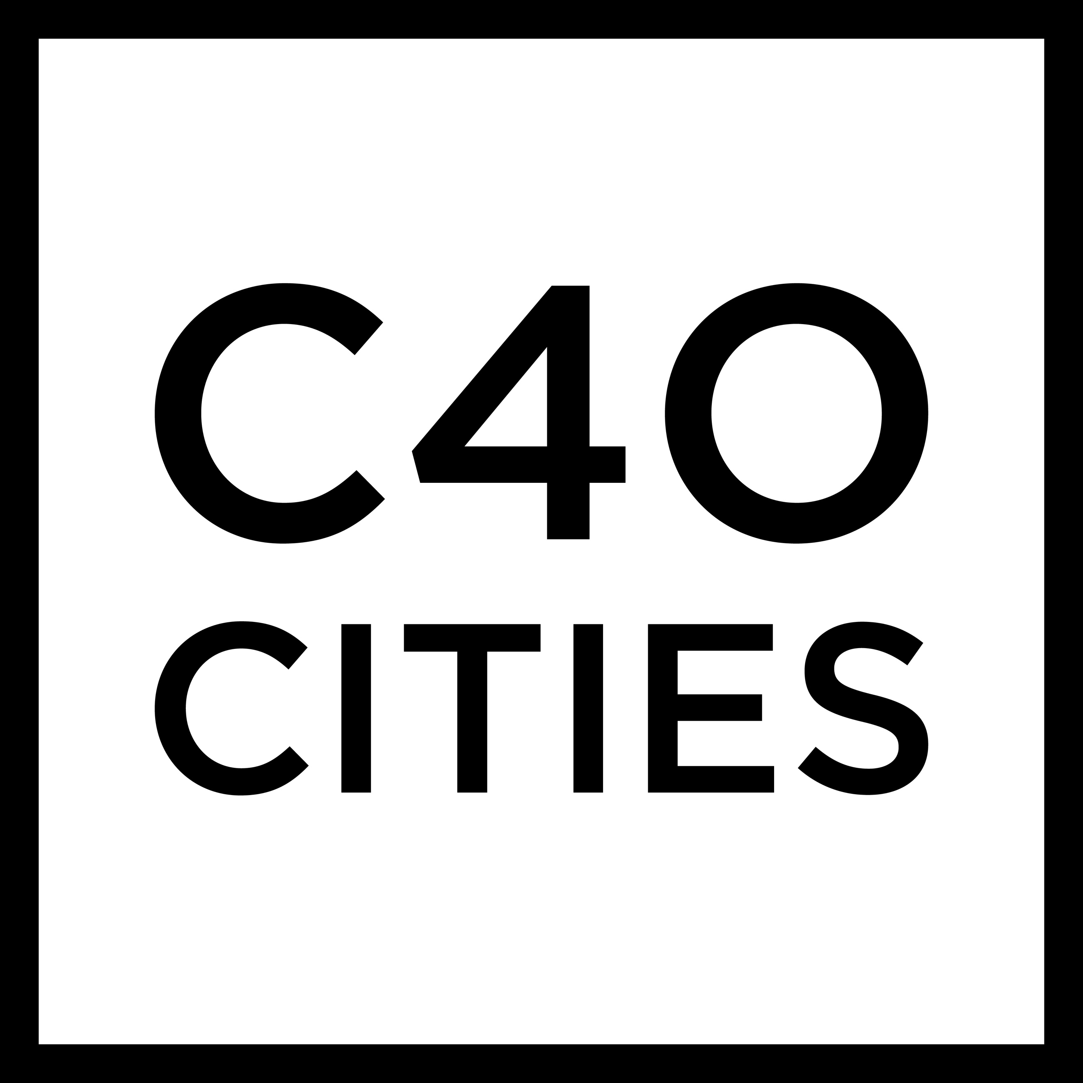
SEIZING MEXICO’S
URBAN OPPORTUNITY
urbantransitions.global
#UrbanOpportunity
Co-managed by
Report funded by
In partnership with

